Slide 1
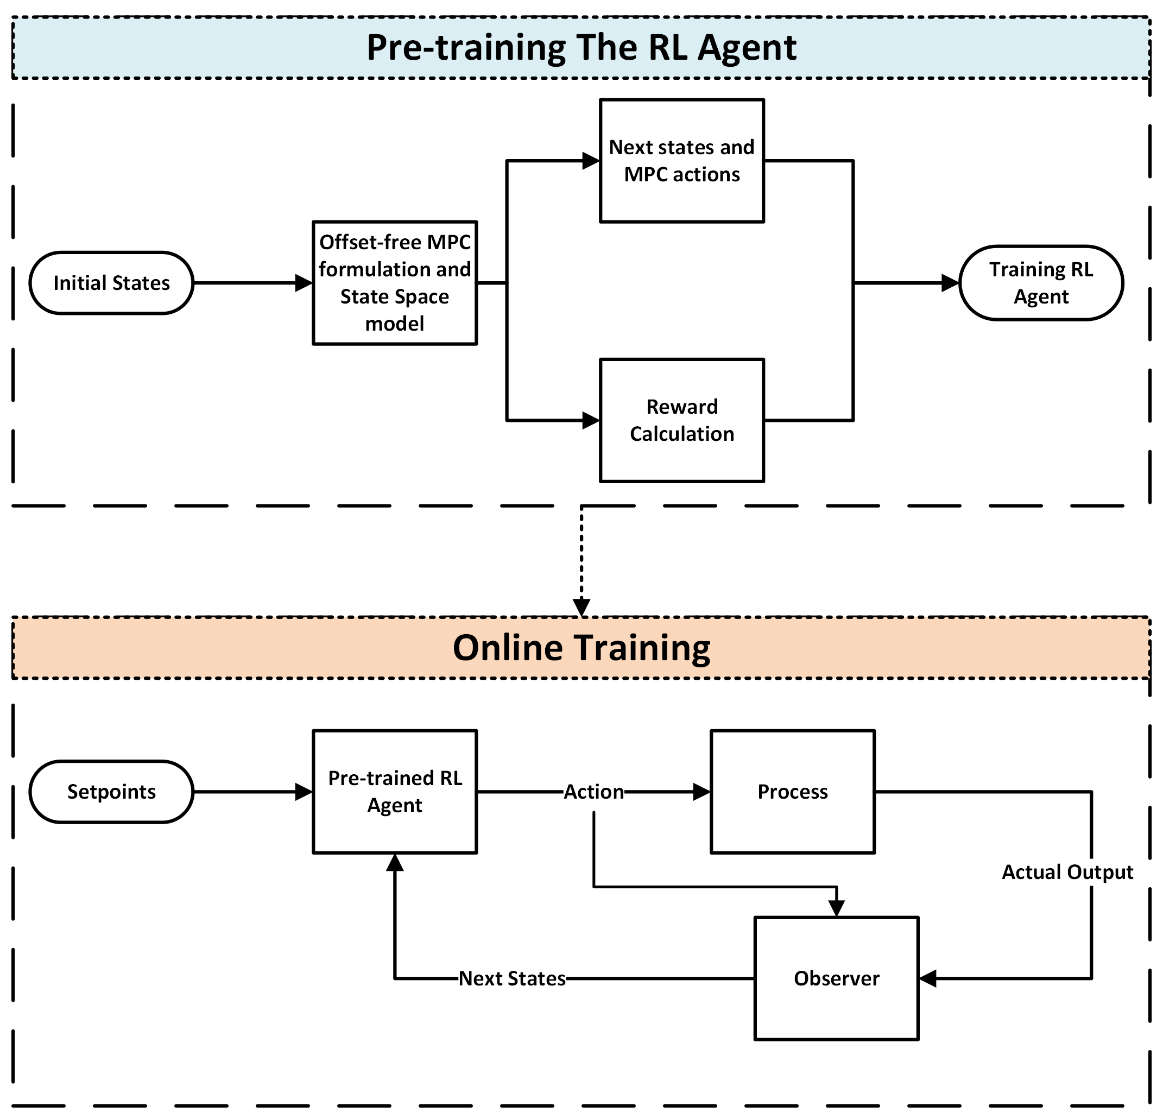
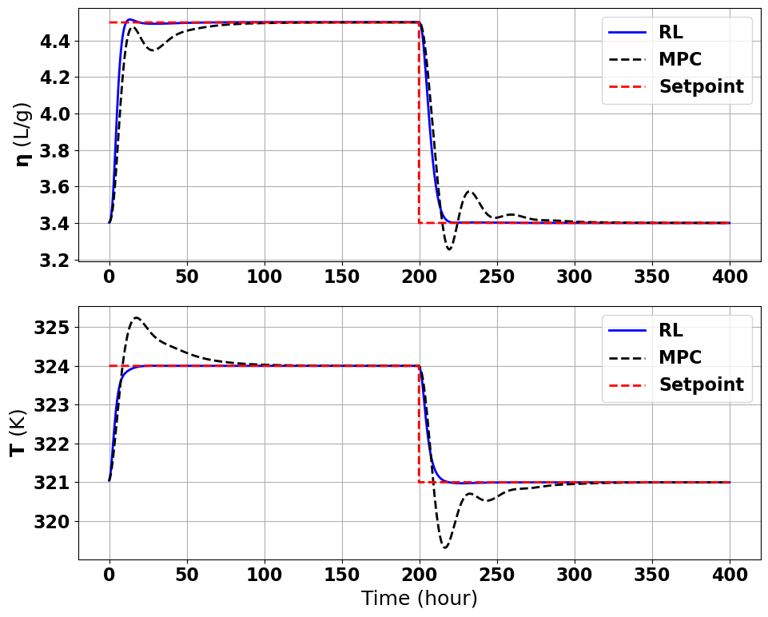
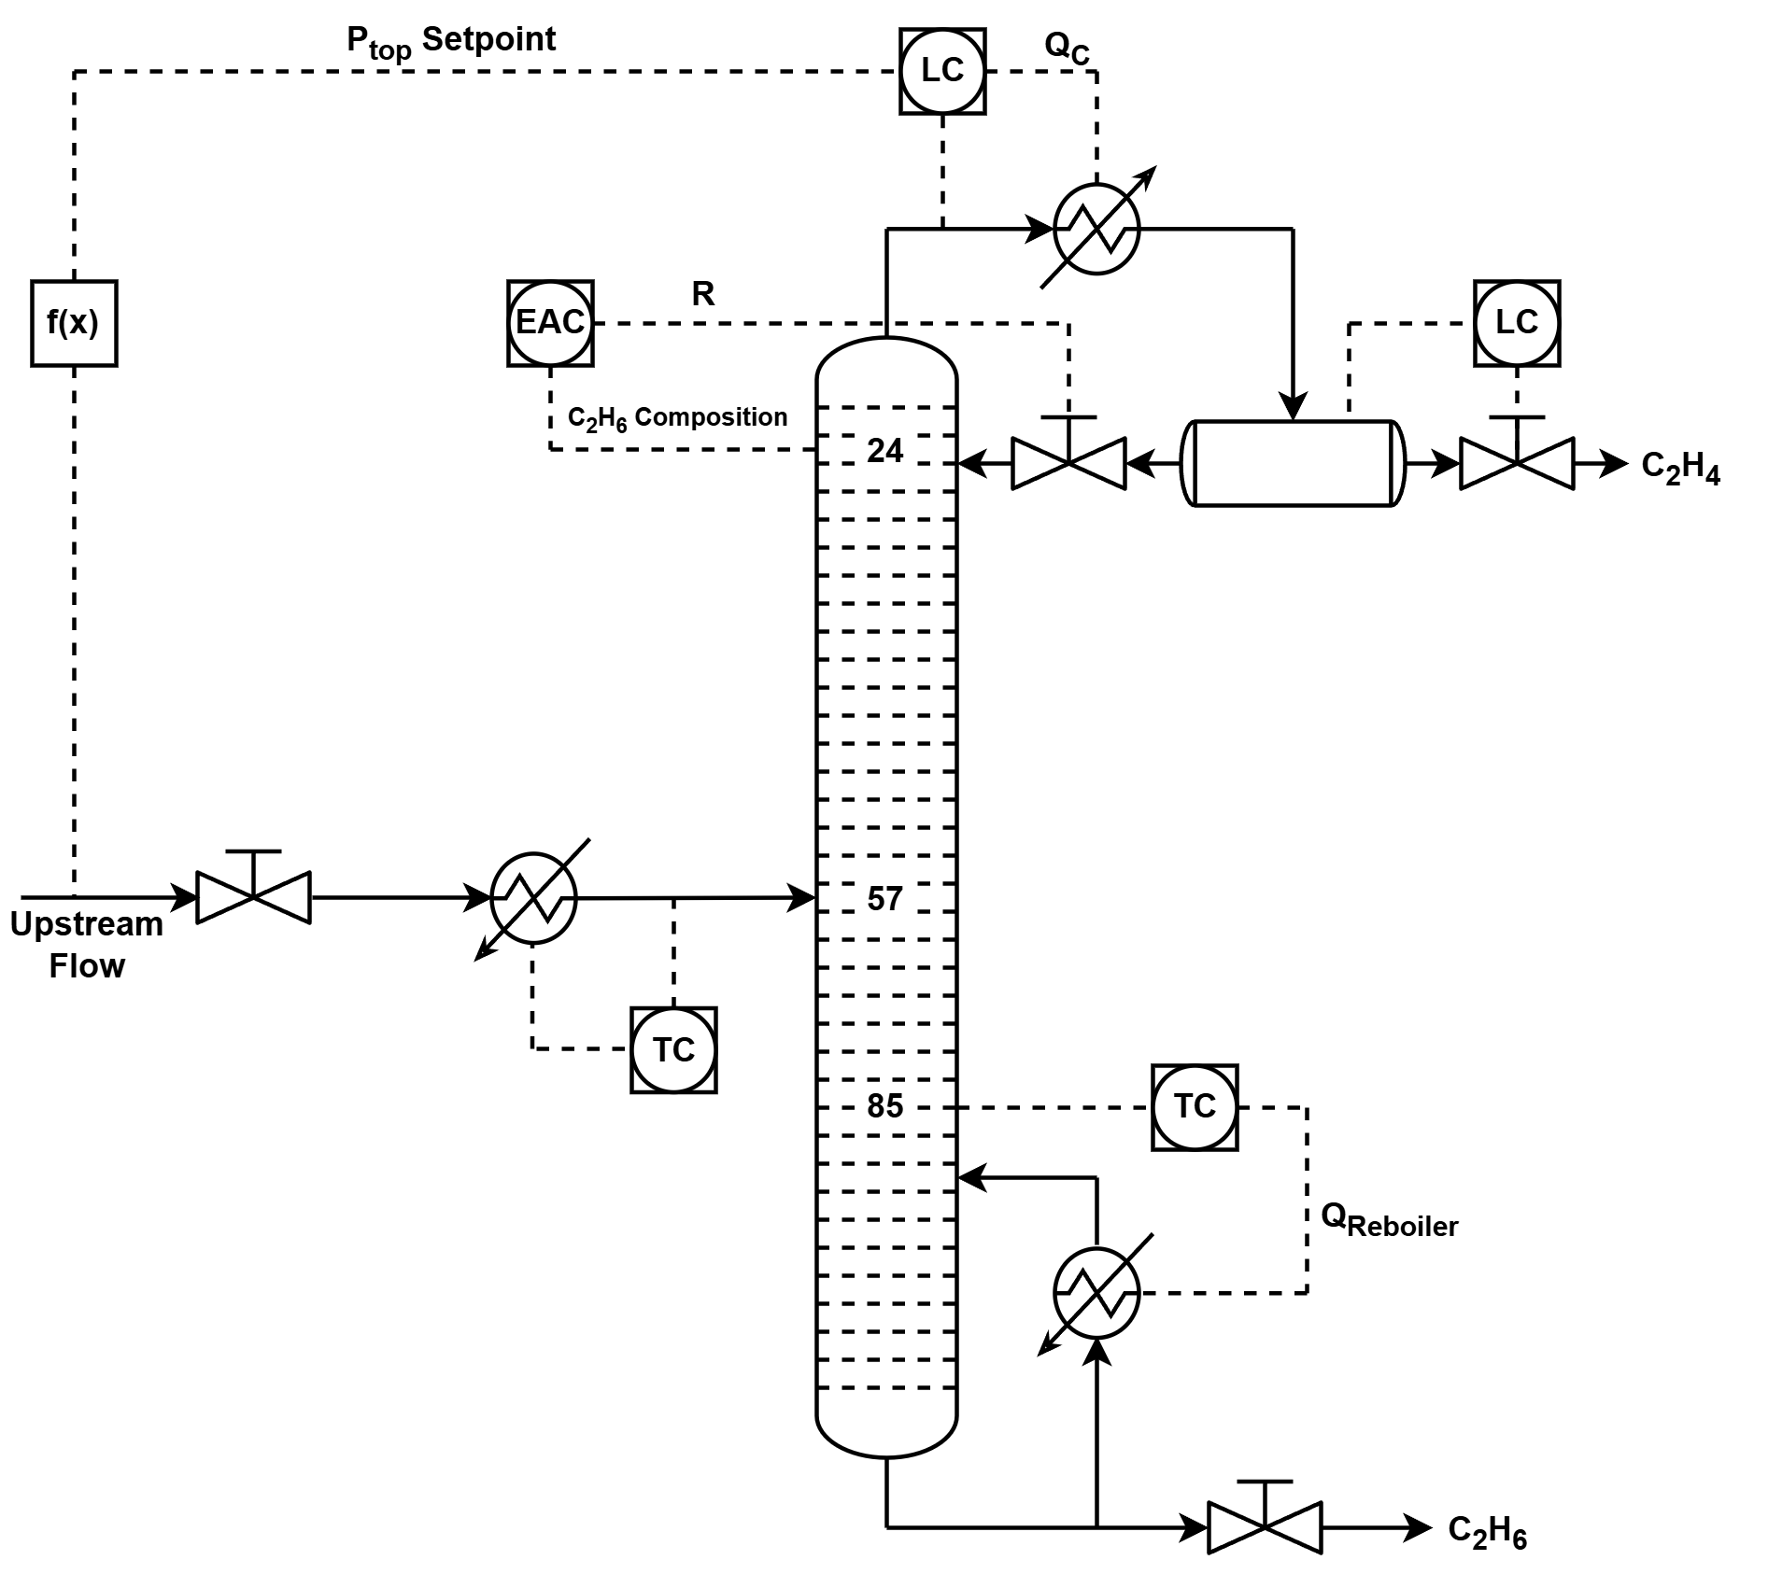
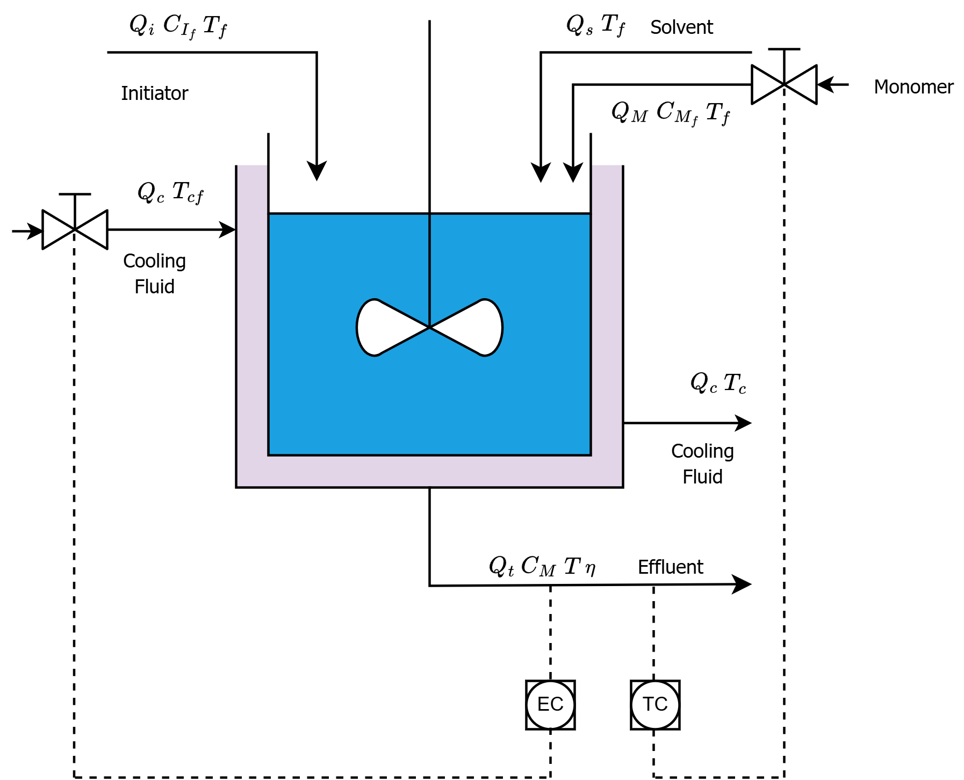
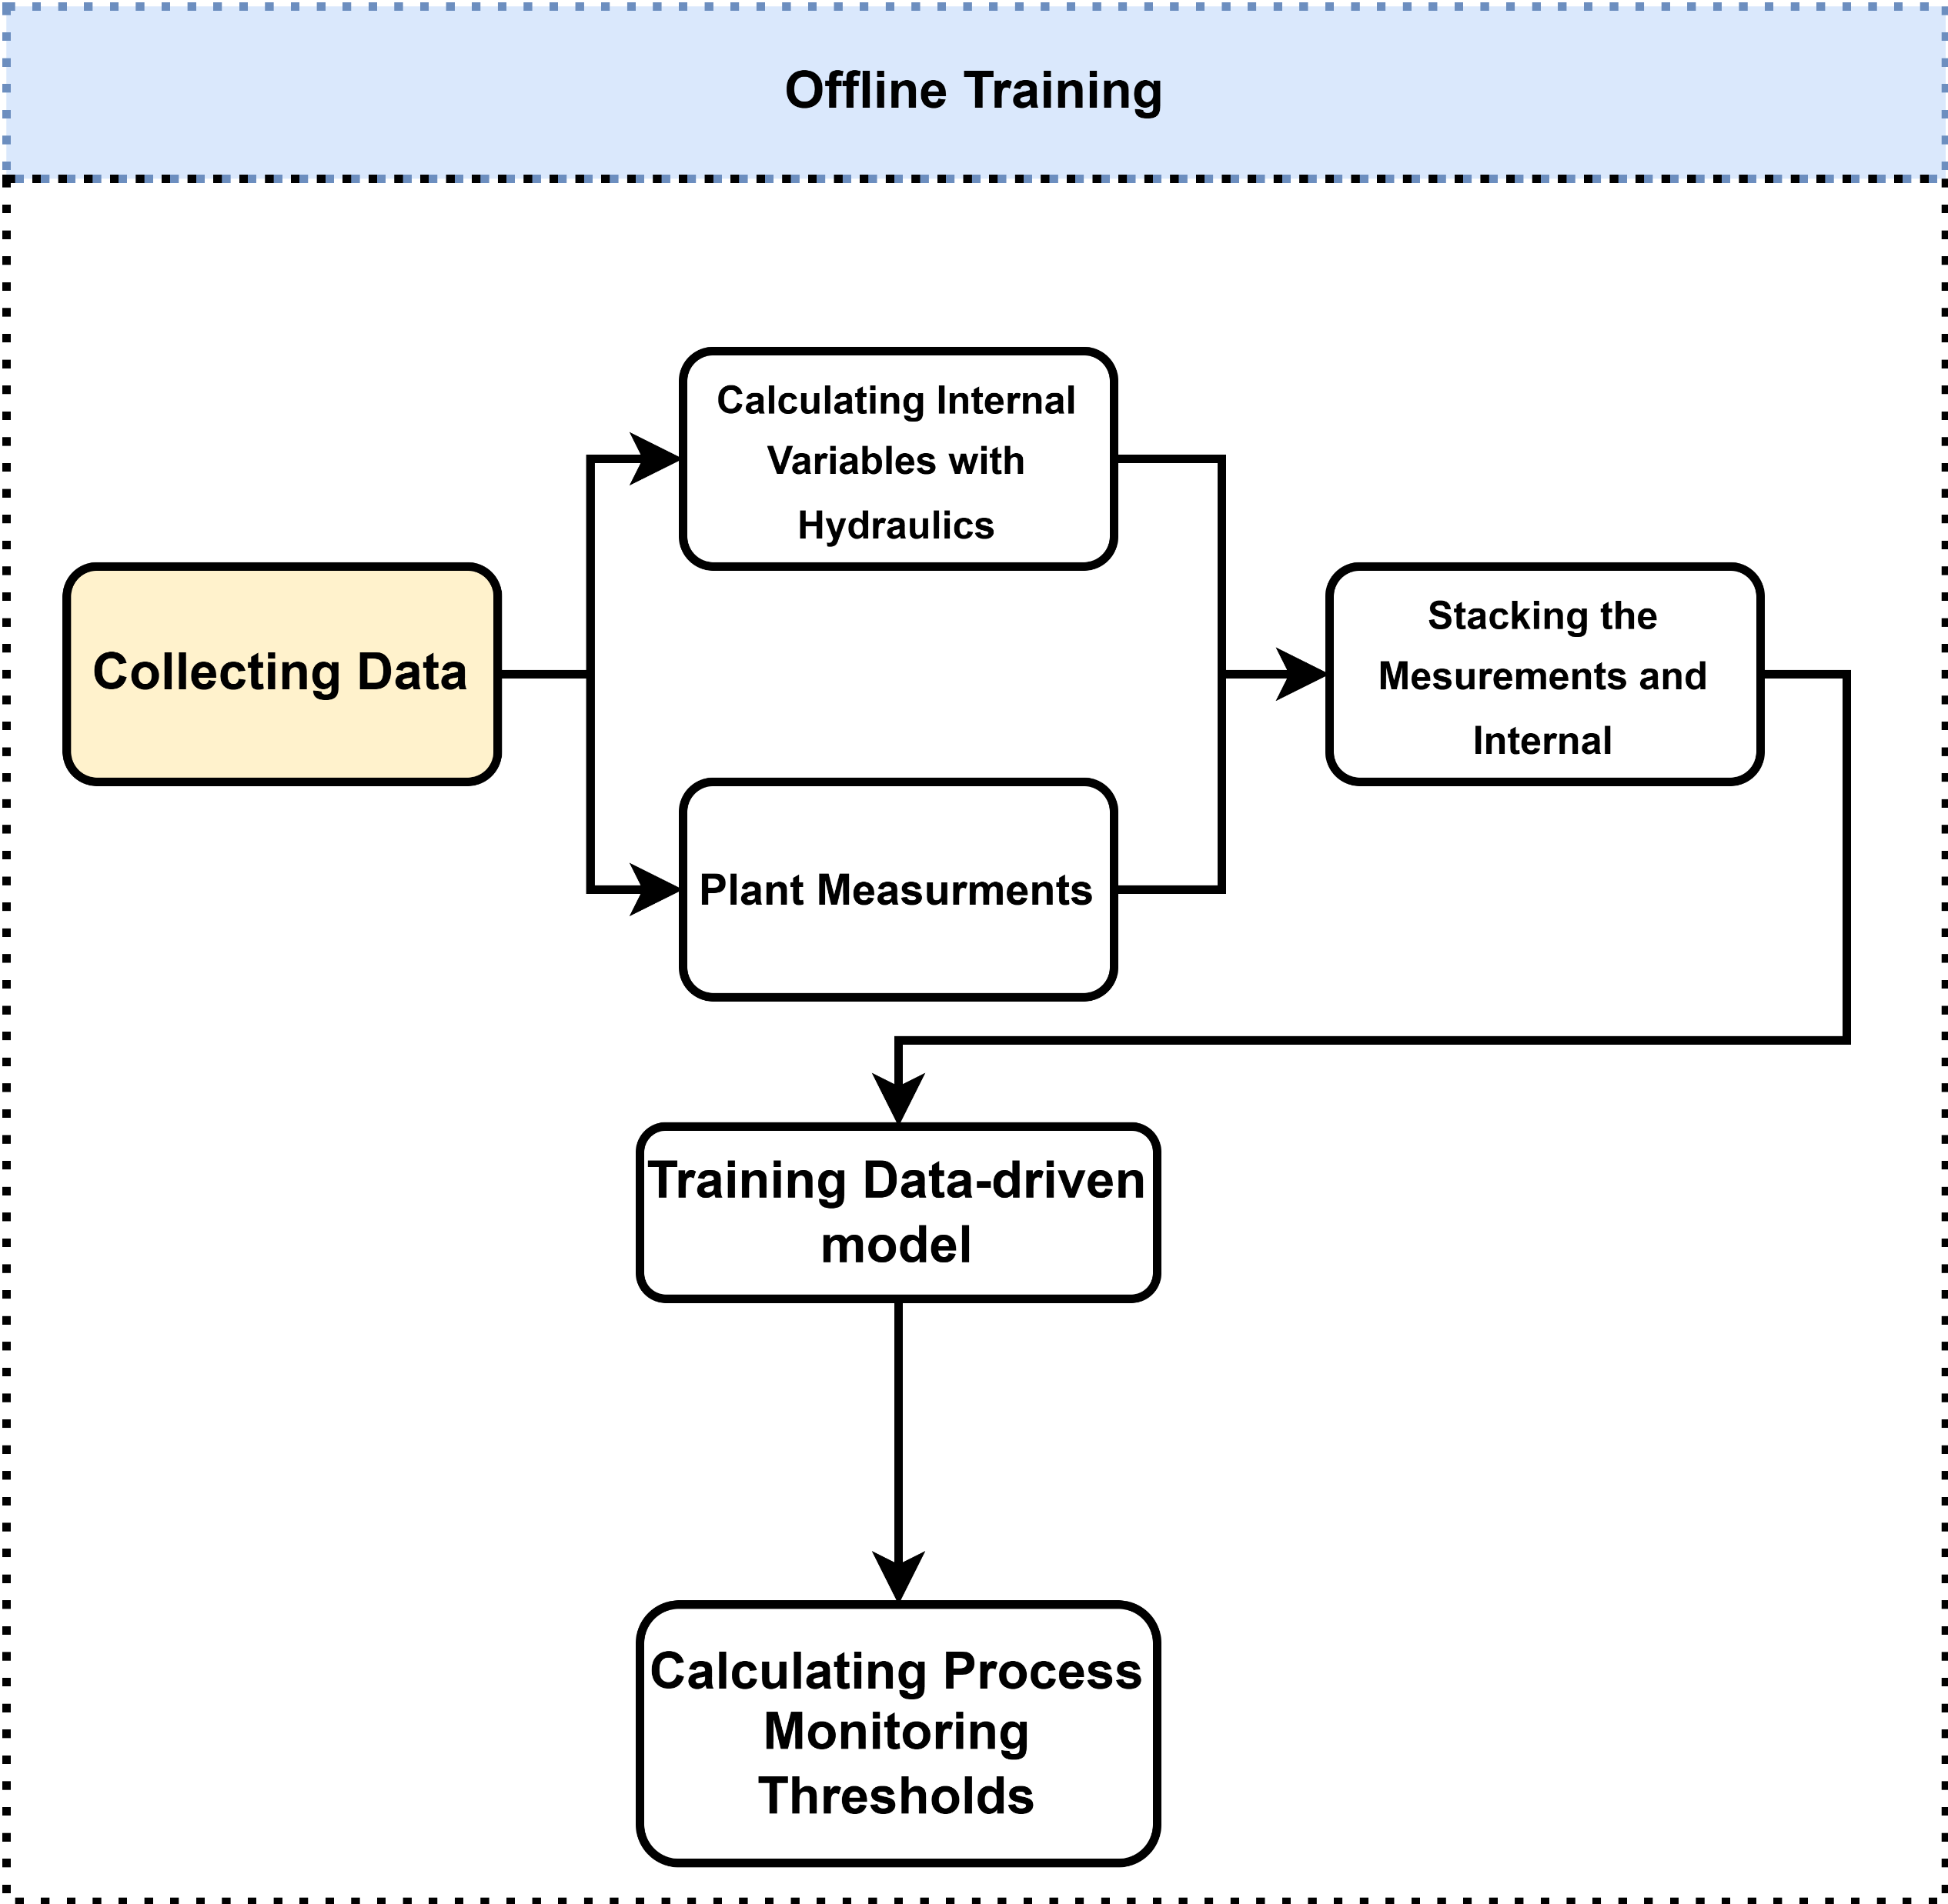
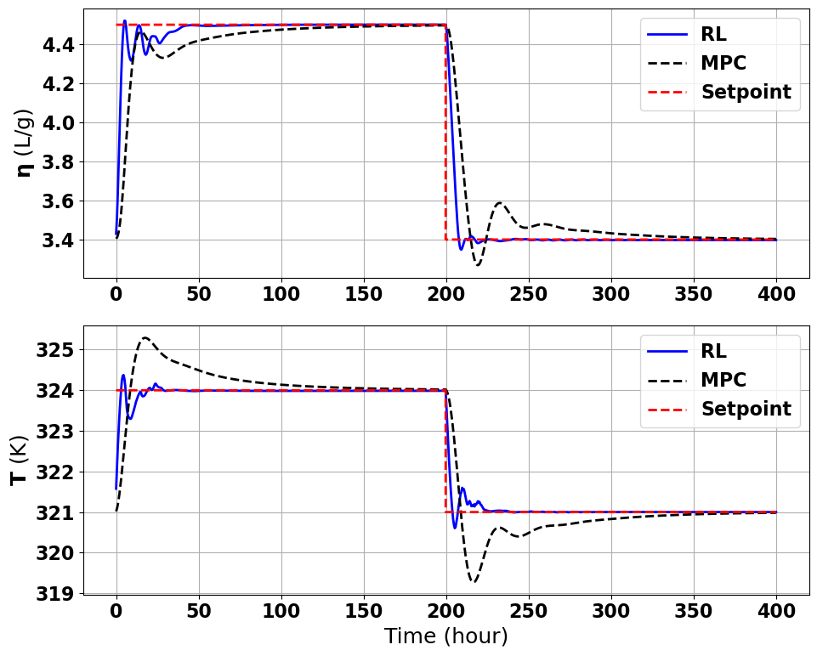
Data-driven Approach for Control and Fault Detection
Problem Definition and Objective
Proposed Approach
Results
Problem
product quality, plant safety, economic efficiency.
faults
Objective
robust controller that handles targets
1- Practical RL Control Implementation
Nominal Conditions
Case Studies
C2 Splitter
Polymer
2- Hybrid First-Principles Data-driven FDD
Under Disturbance
Amir Hossein Hamedi Supervisor: Dr. Mhaskar
MACC Annual Meeting 2025

